Slide 1
IBMS Training for Trainers
17th May 2024
Registration Portfolio Verification
Process and Guidance
Sue Jones PhD, FIBMS, MRSB, PFHEA, NTF, CATE IBMS Executive Head of Education suejones@ibms.org

Slide 2

Benefits of Verification
Sharing good practice
New examples of evidence
Inform your own training
Co-ordinated training plans /
collaboration
Building your network
Quid pro quo!

Slide 3
Verification
Definition of “verification” (noun)
the act of verifying something
(ie proving or checking that it exists, or is true or correct)
https://dictionary.cambridge.org/dictionary/english/verification
The training officer will apply for a verification once the Registration Training Portfolio has been completed and the candidate is ready for assessment

Slide 4
Verifier Allocation
Weekly emails from registration@ibms.org
Please reply if you can do one (or more) verifications
The verification can be online / hybrid or face to face – you can specify
You will then be allocated to the oldest portfolio waiting for verification
You can be nominated to complete a verification by a Training Officer BUT only for a different Trust / site and have had no involvement in the candidate’s training.
The IBMS must organise and authorise this verification for our records BEFORE the verification

Slide 5

Potential Verification Issues
You can’t seem to get a verification date organised (no response, unavailability etc)
The portfolio evidence is not good enough
The trainee is really upset / nervous / stressed
The IT isn’t working on the lab tour
The trainee doesn’t demonstrate the required knowledge and understanding on the lab tour
You have concerns about the lab training
The training officer disagrees with you

Slide 6
How to Approach Issues
Calmly
Nothing is irretrievable
Communication
  Talk to the lab
  Talk to the IBMS
  Flag any concerns – we will follow up
You are the Verifier
Don’t avoid a difficult conversation
You are our eyes and ears to spot issues

Slide 7
Verification Organisation
Once a verifier is allocated, contact details and IBMS documentation (verifier report form and laboratory feedback form) will be provided
The verifier is required to contact the training officer within one week to arrange a mutually convenient date for the verification.
It is up to the training officer to ensure that the candidate is made aware of this and can attend the agreed verification date.

Slide 8
Portfolio Evidence
We recommend that the verifier asks for the portfolio and evidence AT LEAST 7-10 days before the agreed verification date
Version 4 portfolio - check that you can open and access all evidence electronic files and there are no issues or missing pieces of evidence
Version 5 portfolio - check that you receive your log in and can access the OneFile portfolio evidence, and there are no issues or missing pieces of evidence
This will allow you to address any issues with the evidence BEFORE you start your online review

Slide 9
Portfolio Review
The verifier reviews the portfolio evidence in advance of the verification (fully online, or face to face visit)
The indicative time for portfolio review is 90 minutes
The verifier must ensure that the portfolio has been completed and that ALL the standards of proficiency have been evidenced
The verifier usually starts the verifier report form / recording comments on each piece of evidence as they review them and noting areas to explore during the lab tour

Slide 10
Issues with Evidence
The verification should only go ahead when the verifier has reviewed all pieces of evidence and is happy that the evidence demonstrates the HCPC Standards of Proficiency adequately
Minor issues / concerns about the candidate’s knowledge and understanding can be addressed by additional questions in the lab tour during the verification
If the verifier has serious concerns about the evidence provided and does not think that the portfolio is at the required standard, the verification can be postponed

Slide 11
Verification
Informal Interview with Candidate and Training Officer (15–20 mins) this is an opportunity for everyone to be put at ease.
It is important that the trainee is encouraged to talk about their training experience and give their views on the training provided
Verifiers will also confirm:
There was inter-professional learning with other learners
Candidates can demonstrate how to raise a complaint if they
have concerns about the safety and well-being of service users
and how to ensure action has been taken

Slide 12
Verification
Tour of Laboratory (40 mins)
This must be conducted by the verifier and the
trainee only
This part of the process gives the trainee the
opportunity to demonstrate their fitness to practise
through the knowledge and competence they have
achieved during their training
This should not be a monologue but an interactive
discussion

Slide 13
Verification
Tour of Laboratory (40 mins)
An overview of facilities, equipment and environment. The candidate must be able to articulate basic knowledge of the procedures, techniques and equipment.
Proactive question-and-answer session where the verifier
ensures that the candidate has the threshold knowledge and
skill required for the role of a biomedical scientist.
Provides an opportunity for the verifier to probe any areas
they feel need clarification after having reviewed the
portfolio evidence
Include questions on the updated HCPC SoP areas

Slide 14
Verification
Optional Meeting with Training Officer (15 mins)
This is an opportunity to raise any issues or concerns identified during the verification visit.
If no issues have been identified, the verifier can proceed to the next stage immediately.

Slide 15
Verification Feedback
Feedback Comments to Trainer and Candidate (15 mins)
The verifier communicates the outcome of the verification and the recommendation they will make to the IBMS in their report – ie if the candidate has passed.
The verifier should also give constructive feedback, eg
How portfolio evidence or the training strategy could be improved
Developing a collaborative and coordinated approach to training across the disciplines
Maximising the use of resources to avoid the same training being replicated unnecessarily to several trainees
Identify and celebrate good practice

Slide 16
Verification Outcomes
Successful (pass)
The candidate has demonstrated the minimum competence required for each standard of proficiency.
The verifier recommends that the candidate should be awarded the IBMS Certificate of Competence.

Slide 17
Verification Outcomes
Unsuccessful (fail)
The candidate has not demonstrated the minimum competence for several areas of the portfolio and cannot demonstrate that they meet the standards of proficiency
The verifier will give feedback on deficiencies identified the portfolio / lab tour.
The verifier determines whether submission of additional evidence will address the deficiencies, or a further full verification is required.
The verifier and trainer agree a reasonable deadline to provide any additional evidence (if appropriate).

Slide 18
Verification Outcomes
Unsuccessful (fail)
The original verifier will complete the second verification unless the candidate, training officer or verifier would prefer not to
The new verification date will be organised (once the candidate has undertaken further training and / or updated their evidence)
Only the new / additional evidence might need to be verified, or if there are serious issues, the whole portfolio might be re-submitted and the lab tour done again

Slide 19

Tying up Loose Ends
Tell the candidate and trainer the outcome of the verification
Put it all in the verifier report!
Reflect on your experience
Identify good practice
Identify areas for improvement
Don’t forget the lab feedback form
If a trainee does not meet the standards required,
you can refer them for re-assessment (with feedback)

Slide 20
Verification Report
All verifiers are asked to confirm that the candidate has met all HCPC standards of proficiency in all modules
If some standards have not been met through the evidence, these must be met through discussion with the candidate during the verification to pass
It is good practice to add brief notes about each piece of evidence and what was good about it / required improvement per module in the verifier report form

Slide 21
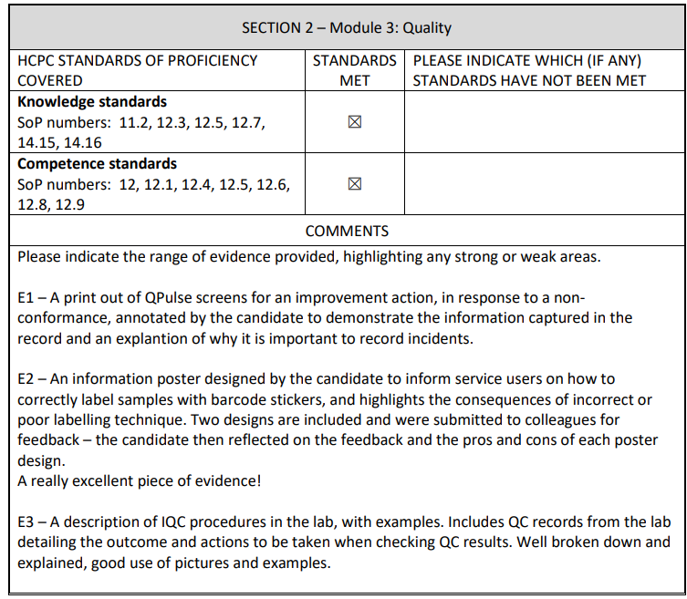
Verification Report (V 4.3)

Slide 22
Verification Report
At the end of the report, you should add overall comments about the quality of the evidence submitted, how the candidate performed and the training environment
You should comment on the training plan / laboratory training process
You should note any constructive feedback given to the training officer and good practice identified

Slide 23
Verification Forms
Version 4 Portfolio - The verifier report must be returned to registration@ibms.org within 1 week of the verification
Version 5 Portfolio - The verifier report is on OneFile and must be completed within 1 week of the verification
The laboratory must also complete a feedback report on the verification and return that to registration@ibms.org within 1 week of the verification (Version 4.3) or on OneFile within 1 week for Version 5.0
If either report is not received, the Certificate of Competence cannot be processed

Slide 24
Verification Report - Issues
We have a process for receiving and screening reports and identifying issues
If a candidate, verifier or training officer raises a concern about the verification or the quality of the laboratory training, we follow up
Executive Head of Education and Head of Learning and Development (experienced training manager and HCPC registrant) speak to all concerned

Slide 25
Verification Report - Issues
The Executive Head of Education and Head of Learning and Development agree an action plan and timeline to resolve issues
Training approval can be suspended if serious issues
Progress reviewed and future verifier reports scrutinised to check that issues have been resolved

Slide 26
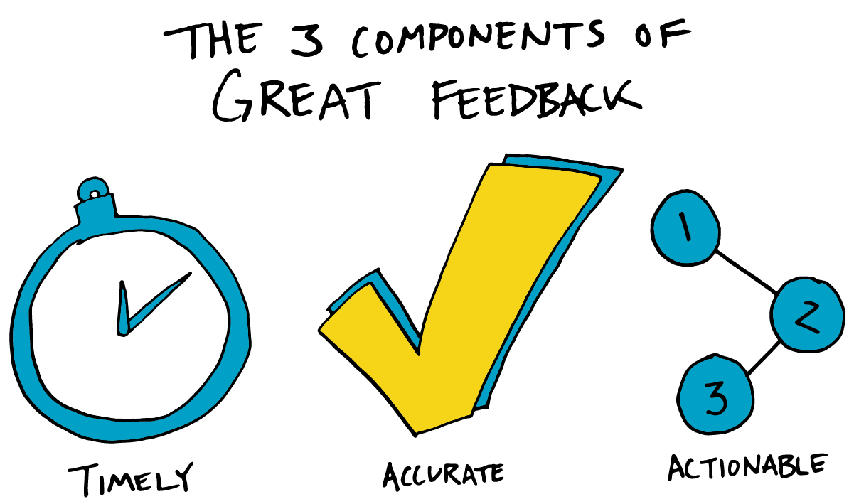
Report Writing…

Slide 27

Thank you –
Any questions?

