Slide 1


Leadership in Biomedical Science
IBMS SUPPORT HUB
Paula Simpkin
Senior Lecturer in Biomedical Science
Sheffield Hallam University

Slide 2
Today’s topic....
Leadership and Management of Laboratory Services – What skills do I need and how do I develop them?
This support session will focus on the development of leadership and management skills for Biomedical Scientists aspiring to Senior BMS roles or those laboratory roles requiring a greater degree of technical and/or managerial responsibility (eg training, quality, health and safety, managing staff/teams or specialties of service).
We will look at what these skills are and the opportunities to support the development of them.

Slide 3

“The pessimist complains about the wind. The optimist expects it to change. The leader adjusts the sails.”
-John Maxwell

Slide 4
What is leadership?
Leadership means different things to different people.
"Leadership is a process whereby an individual influences a group of individuals to achieve a common goal."
Northouse, P. G. (2018). Leadership: Theory and Practice.
Leadership is a set of mindsets and behaviours that aligns people in a collective direction, enables them to work together and accomplish shared goals, and helps them adjust to changing environments.
Compassionate Leadership is the practice of using your head and heart to inspire and influence people so they can inspire and influence others.
And many others....

Slide 5
Leadership Skills, Qualities and Attributes....
Communication (written/verbal)
Collaboration
Adaptability and Agility
Motivated
Problem Solving
Initiative
Delegation
Empowerment
Compassion
Time management
Project management
Expertise
Team building
Positive relationships
Organisation
Calm in a crisis
Developing others
Negotiation and influence
Networking
CPD
Decision making
Respomsibility
Integrity
Accountability

Slide 6
“I’m not a manager so how do I demonstrate and develop leadership skills?”
Leadership is not the same as management...
Not all leaders are managers (but all managers should be good leaders)
You need these skills BEFORE you become a manager and in order to become one.
You are already demonstrating these skills (because you have to as part of your role).
Think about those people you work with, admire, wish to emulate. Are they managers? They might not be...What is it they are doing that you admire – this is probably a leadership attribute.
Developing leadership skills involves a combination of education, practical experience, and personal development.

Slide 7
Why are leadership skills important in Biomedical Science?
Leadership skills are essential for the safe and successful delivery of the services we provide. Ensuring high-quality patient care, operational efficiency, performance and innovation.
HCPC Standards of Proficiency : Leadership is all over these standards but specifically....
8.6 understand the qualities, behaviours and benefits of leadership
8.7 recognise that leadership is a skill all professionals can demonstrate
8.8 identify their own leadership qualities, behaviours and approaches, taking into account the importance of equality, diversity and inclusion
8.9 demonstrate leadership behaviours appropriate to their practice
Notes:
Think about when things go wrong, the Lettby’s etc
It’s because there is a lack of accountability, responsibility, a blame culture, people are frightened to speak up and raise concern for fear of reprimand or consequence. This all comes from bad leadership. Difficult conversations can be had if they are handled correctly. Well lead teams and services are safe places to work, they are efficienct, they are innovative, supportive, compassionate, quality improves, morale improves, well being improves...

Slide 8
“I’m not in a leadership role”
Oh yes you are...
Think of what you do every day...chances are you are already demonstrating these skills and attributes.....
Initiative, problem solving, communication (civility), demonstrating good professional conduct and practice, mentoring, training, supporting colleagues, special areas of responsibility, CPD, leading by example, team working, motivating, speaking out/raising concerns, H&S, risk management, reporting incidents, planning rotas, accountability, integrity, flexibility, adaptability, prioritising, organisation, time management, communication within and between teams and other professionals, problem solving, compliance with procedures, training, quality, health and safety......
You are already doing this. Learn to recognise and appreciate these skills in yourself and others.

Slide 9
“ I’d like to move into a Senior BMS/Management role”
You are already demonstrating leadership in your BMS band5/6 role but for roles with responsibility and accountability for staff and service, leadership skills are a pre-requisite.
You need to be able to demonstrate this and provide examples at interview/application.
Are we good at developing these skills?

Slide 10
“Where do I start?”
It starts with you. Know yourself. Self Awareness.
What are your strengths? What needs development? Find out.
Ask your managers. Ask your Colleagues. Use it as a personal/professional development opportunity. An element of resilience is required here!
Talk about it at your appraisal (setting objectives and action plans for development).
Use a leadership tool. 360 degree assessments. Self-assessment tool – Leadership Academy (free)
What sort of leader are you? Does this align with the leader you want to be?

Slide 11

Make an Action Plan
Once you’ve identified what you need to work on , develop an improvement action plan.
Identify opportunities within the workplace (or out of the workplace) to support development.
NHS Leadership Academy – lots of resources!
Take a leadership course.
Develop your Reflective Practice skills
Get involved

Slide 12
Get involved! For example...
Training – supervising/mentoring others. Developing others, supervision, mentoring.
Is there a project or improvement process you could lead/take part – project management. UKAS findings/incidents/quality management
Work with other professional groups to develop/support services – collaboration, networking, team working.
Delivering the needs and priorities of service Planning and organising rotas. Delivering this compassionately taking into account the staff that deliver it.
Become a champion – what is important to you? Mental health and well being, Sustainability, EDI, Public engagement, interprofessional working, improving morale...
Create CPD opportunities to develop self and others. Lunchtime seminars/journal clubs?
Ask for some additional responsibility- overseeing a section, EQA/IQC, QM (incidents, documentation, UKAS issues) Contribute to the resolution of issues. Use your initiative whilst working within your limitations and scope of practice.
Consider your behaviour – model positive behaviours and approaches to problems
Influence and negotiate changes (higher level skills)
Managing change – supporting others, identify opportunities
Celebrate successes
Reflective Practice
Network : participate in events to network with other professionals and leaders in your field (IBMS).
Keep a record of activities you take part in – expect questions on this at interview so have some examples ready.

Slide 13
Senior Leadership and Management
Good leadership in Senior positions is an essential requirement.
Know yourself, your team, your service and the wider organisation of which you are a part.
Familiarise yourself with NHS policies, procedures, and organisational structure
Knowledge and awareness of wider elements of service delivery is required. Budgets/finance, HR management, Business and Procurement, strategy, policy, accreditation, compliance and regulation etc.
Managing staff, managing personal well being, resilience, delegation, report writing, dealing with other professionals, difficult HR issues, , accountability, responsibility, managing change, collaboration, communication, chairing meetings, conflict management, strategic planning, appraisals, difficult conversations, developing others.....

Slide 14
Developing Senior Leadership Skills
Show an interest. Talk you your seniors and senior management about their role, their journey etc. Raise it as an aspiration in your appraisal of professional development. Show that you are keen and motivated to progress.
Shadow senior staff, observe the activities they perform, think about the leadership skills they are demonstrating.
In terms of supporting practical skill development, there are courses. In terms of general leadership – look at the NHS leadership academy, look at your own Trust catalogue.
Most senior BMS positions require an MSc or IBMS HSD. Talk to your training officer/managers about this and what support might be available. Consider a leadership MSc rather than science based – employers are saying these are more valuable in terms of addressing skill development and skill gaps
Consider an apprenticeship – hard work but no fees.

Slide 15
Useful Resources
https://www.leadershipacademy.nhs.uk/
https://www.leadershipacademy.nhs.uk/programmes/
https://www.ibms.org/resources/documents/ibms-higher-specialist-diploma-study-guide/
https://www.hcpc-uk.org/standards/standards-of-proficiency/revisions-to-the-standards-of-proficiency/leadership/
https://www.hcpc-uk.org/globalassets/standards/standards-of-proficiency/updated-standards-themes/fact-sheets/leadership.pdf
https://www.ibms.org/resources/ibms-mentoring-scheme/

Slide 16

Questions?

Slide 17



@msc_mres_shu_biochem
@MscMres
Department of Bioscience and Chemistry

Slide 18
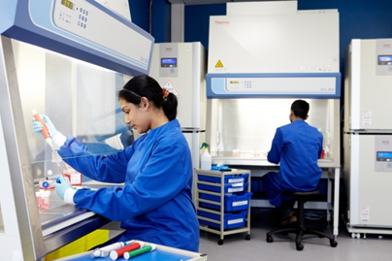
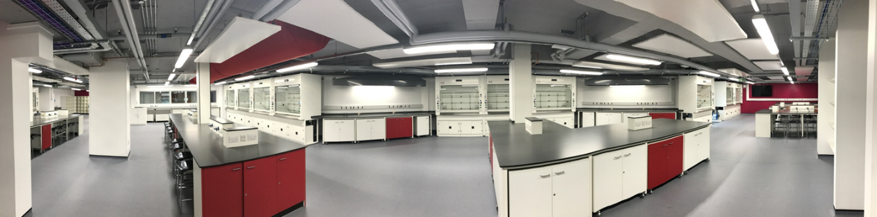
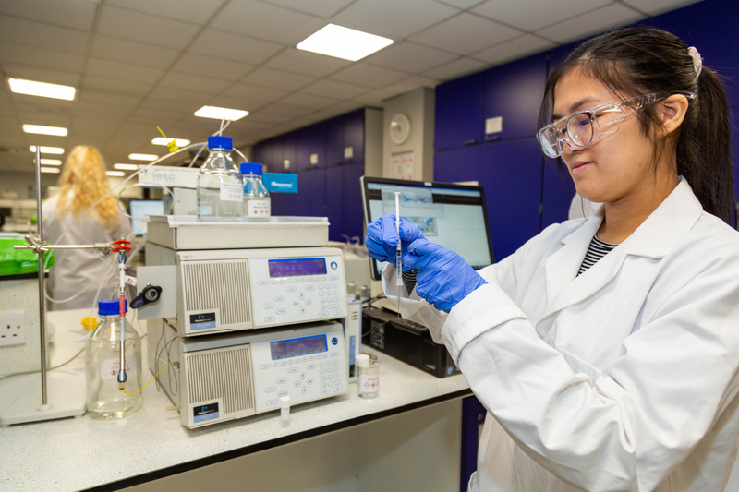
Department of Bioscience and Chemistry
    MSc and MRes Courses IN THE FOLLOWING AREAS
        Biomedical Laboratory Sciences
        Cancer Biology
        Molecular Microbiology
        Pharmacology and Biotechnology
        Analytical Chemistry
        Pharmaceutical Analysis

Slide 19


why choose us?
        One of the largest and most popular universities in the UK, with over 30,000 students from more than 100 countries enrolled
        Our research is world leading or internationally excellent
        We have active research groups that reflect our postgraduate course specialisms
        Our applied laboratory-based teaching inspires and challenges our students
        Support available to you during your time at Sheffield Hallam is vast

Slide 20
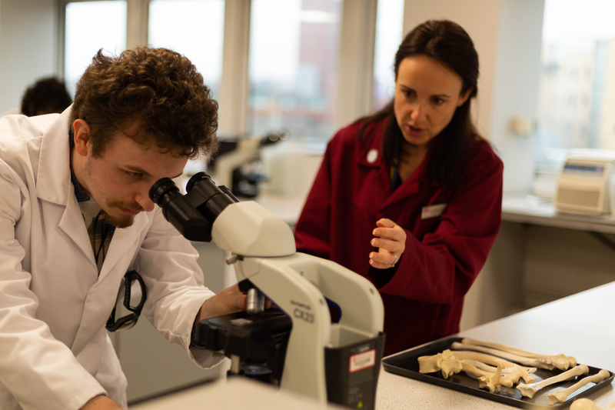
HOW will YOU STUDY?
    Co-created learning and teaching
    activities engage students within innovative spaces
Cell culture Laboratories
Microscope suite
Analytical Laboratory
Microbiology Laboratory
Mass Spectrometry Imaging
Molecular Biology Laboratory
Biochemistry Laboratories
Chemistry Laboratory

Slide 21

COURSE STRUCTURE

Slide 22
Flexible Study Patterns
You can do a full MSc which is 180 credits
MSc can be studied full-time or part-time
MRes courses are full time only
Study individual modules for continuing professional development
Postgraduate Certificate (PgCert) is 60 credits
Postgraduate Diploma (PgDip) 120 credits

Slide 23
MSc Course structure
20 credits (skills and laboratory provision)
40 credits course content
Trimester 1 Sept-Jan
20 credits (skills and laboratory provision)
20 credits course content
20 credits course content/elective
Trimester 2 Jan- May
Trimester 3 June -Sept
60 credits research project
Our new curriculum is designed to ensure that you have undertaken both formative and summative assessment and received marks and feedback prior to the Christmas vacation

Slide 24
MRes Course structure
Share Trimester 1 with the equivalent MSc course
Trimester 1 Sept-Jan
Trimester 2 Jan- May
Extended Research project
Trimester 3 June -Sept

Slide 25
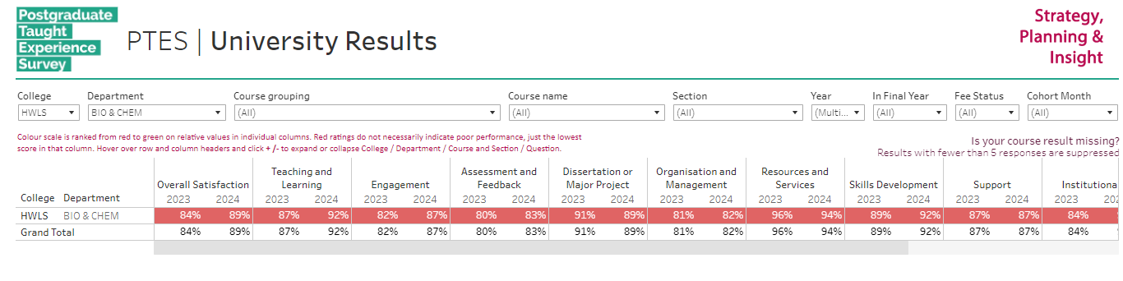
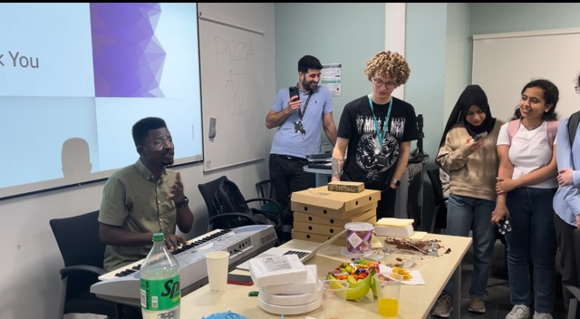
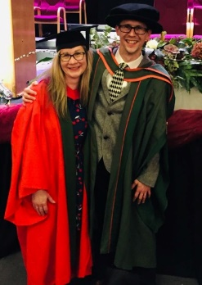
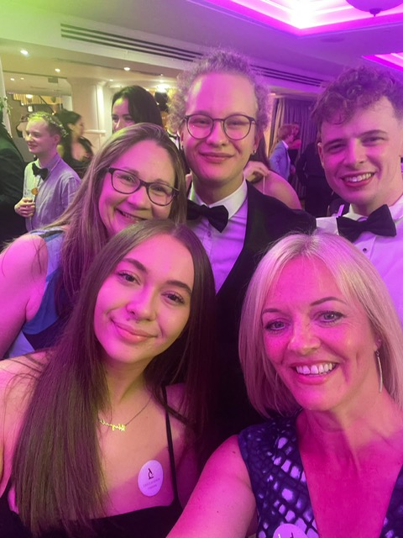

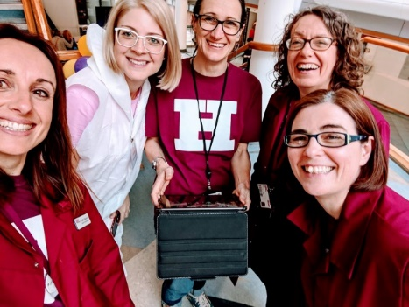

Slide 26



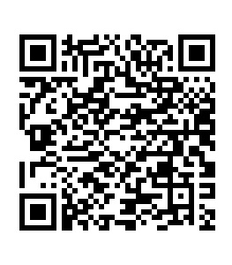

Find out more
    For more information about our courses and for the contact details of our course leaders please visit our websitE
    s.FORBES@shu.ac.uk

Slide 27




@sheffhallamuni
@sheffieldhallamuniversity
@sheffhallamuni
@sheffhallamuni

