Slide 1
IBMS Training for Trainers
17th May 2024
Registration Training Portfolio V5 and Examples of Evidence
Sue Jones PhD, FIBMS, MRSB, PFHEA, NTF, CATE IBMS Executive Head of Education suejones@ibms.org

Slide 2
Event Summary
09:00-09:15 - Sign into the webinar and welcome
09:15-10:00 - Overview of changes to version 5 portfolio and examples of evidence
10:00-10:15 - Comfort Break
10:15-11:00 - Introduction to using OneFile
11:00-11:15 - Comfort break
11:15-11:45 - Verification Process and Guidance
11:45-12:45 - Using OneFile as a training officer and verifier
12:45-13:00 - Questions and open discussion as required

Slide 3
Routes to Registration as a Biomedical Scientist
The IBMS facilitate completion of the HCPC SETs through the degree programme and HCPC SoPs though the IBMS Registration Training Portfolio
  SETs = Standards of Education and Training
  SoPs = Standards of Proficiency
Once both parts have been successfully completed, the IBMS Certificate of Competence is issued
Following receipt of the IBMS Certificate of Competence, the candidate can apply to register with the HCPC as a biomedical scientist

Slide 4
Registration Training
Portfolio Updates
Because the IBMS Registration Training Portfolio is mapped to the HCPC Standards of Proficiency for biomedical scientists, any changes in the HCPC SoPs necessitate changes to the Registration Training Portfolio
The number of HCPC SoPs for biomedical scientists has increased from 105 (2014) to 129 (2022), all of which need to be mapped to the portfolio structure
https://www.hcpc-uk.org/standards/standards-of-proficiency/biomedical-scientists/

Slide 5
Registration Training
Portfolio Updates
Up to and including 31st August 2023
  Registration Training Portfolio applications were issued with the version 4.3
After 1st September 2023
  All applications for the Registration Training Portfolio will be issued with Version 5.0
All candidates (irrespective of portfolio version) will be asked questions about the newly introduced HCPC SoPs at their verification to ensure they are aware of the changes
Information on these questions have been sent to all
verifiers and candidates awaiting assessment

Slide 6
HCPC SoPs Update 2022
Updated wording moves away from passive understanding to active implementation (demonstrating)
The importance of maintaining fitness to practise (looking after own mental health and seeking help where necessary).
More on equality, diversity, and inclusion (EDI)
Service-users – importance of informed consent and effective communication

Slide 7
HCPC SoPs Update 2022
The need to keep up to date with digital skills / new technologies
Role and importance of leadership at all levels of practice
New standards on promoting public health and preventing ill-health
https://www.hcpc-uk.org/globalassets/resources/standards/standards-of-proficiency---biomedical-scientists.pdf

Slide 8
Registration Training Portfolio Version 5.0
The updated / additional SoPs were mapped to the existing module structure of the portfolio
We balanced the SoPs (not necessarily the total number but the evidence required to demonstrate them)
We agreed that the pieces of evidence must cover all SoPs in the module and be listed for each piece of evidence

Slide 9
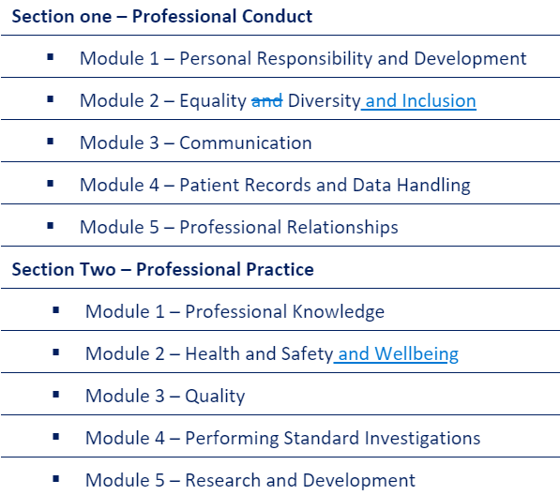
Registration Training Portfolio Version 5.0

Slide 10
Registration Training Portfolio Version 5.0

Slide 11
Why do we Need to Evidence All HCPC SoPs?
Because the HCPC say so…
“The standards of proficiency are the threshold (entry-level) standards we consider necessary to protect the public.”
This means that all candidates must demonstrate that they meet all SoPs at the point of registration and are safe to practise

Slide 12
Registration Training Portfolio Version 5.0
The requirement for 30 pieces of evidence remain
Section 1 Module 5 (Professional Relationships) retains the mandatory reflective statement
ALL modules now have a mandatory piece of evidence:
  This will help to scaffold training and improve consistency
  Details were released in July 2023
  There is also a FAQs document
  Evidence 2 and 3 are the choice of the candidate and training officer

Slide 13
Guidance Documents
Guidance documents for candidates, trainers and verifiers for Version 5.0 portfolio
Contains information on the sections and modules, module learning outcomes and examples of evidence
FAQs
Appendix 2 describes each piece of mandatory evidence
Appendix 3 contains examples of evidence types for each module
https://www.ibms.org/education/registration-portfolio/

Slide 14
How can we Effectively Evidence the Updated SoPs?
The candidate and trainer / mentor are expected to select pieces of evidence that cover several standards of proficiency
The best evidence will demonstrate the candidate’s knowledge and understanding AND how they apply this in a laboratory-based activity / in their practice / in their behaviours

Slide 15
Registration Training Portfolio Version 5.0 Evidence
The mandatory piece of evidence must be
completed as described to meet the indicated
HCPC standards of proficiency (as a minimum)
The remaining 2 pieces of evidence per module will be agreed by the candidate and trainer and must adequately demonstrate the remaining HCPC SoPs mapped to each module
Producing a variety of evidence types across the modules is expected and demonstrates good practice

Slide 16
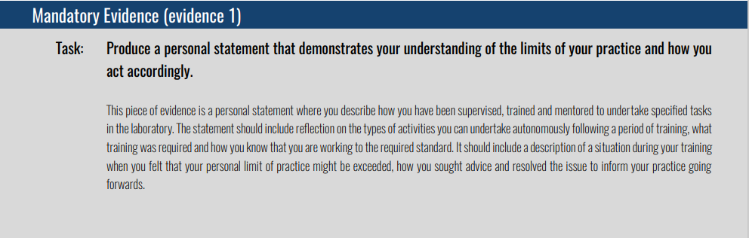
Examples of Mandatory Evidence and Evidences 2 and 3
Maps to SoPs 4.1, 4.5 and 10.1

Slide 17
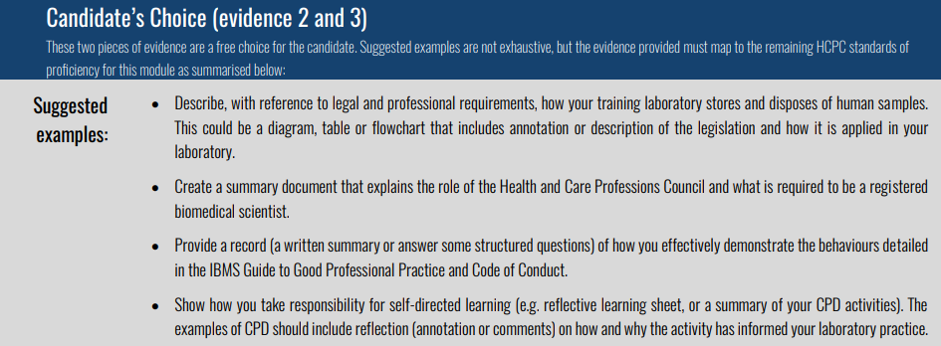
Examples of Mandatory Evidence and Evidences 2 and 3

Slide 18

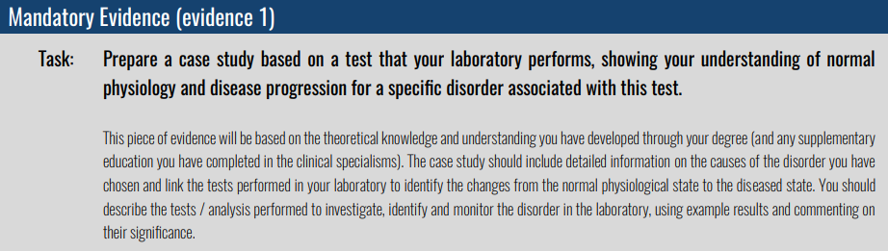
Examples of Mandatory Evidence and Evidences 2 and 3
Maps to SoPs 12.1, and 13.27

Slide 19
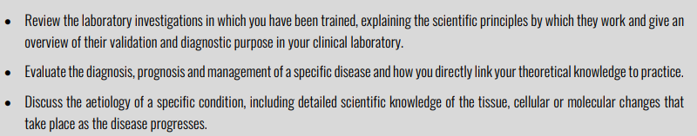
Examples of Mandatory Evidence and Evidences 2 and 3

Slide 20
Size Matters!
Q. Each piece of evidence must map to defined HCPC SoPs, how big should a single piece of evidence be?
Think ‘quality rather than quantity’
It is an important skill to explain complex information in a clear and concise manner to a variety of audiences
Use images (diagrams, data, photos, flow charts) with annotation to demonstrate knowledge and understanding linked to practice
For any single written piece of evidence, we recommend a maximum word count of 1500-2000 words
(excluding the reference list, or hyperlinks may be used for the references within the text)

Slide 21

Good Examples of Evidence?
Focus on pieces of evidence that are clearly linked to the candidate’s own experience and practice:
Reflective statements
Summary of a training tutorial / discussion
Audits (annotated)
Feedback / review of presentation slides
Annotated documents/laboratory results
Question and answer tutorials
Poster or leaflet
Diagram / flowchart (annotated)
Case studies
Data analysis
DOPs (direct observation of practice) with reflection
Scientific pieces of writing (short, clear and concise!)

Slide 22
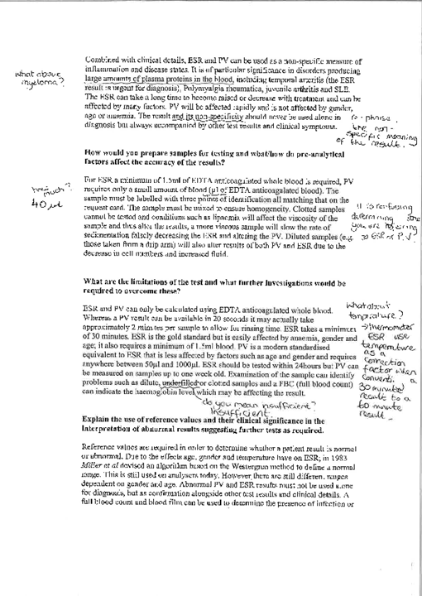
Example Q&As
Good length of answers
Good evidence of marking
Note the response to feedback – training cycle – don’t always have to re-do evidence
Improve by making this specific to a set of results / patient sample
Track feedback / updates digitally using track changes, adding comment boxes or different colour font

Slide 23
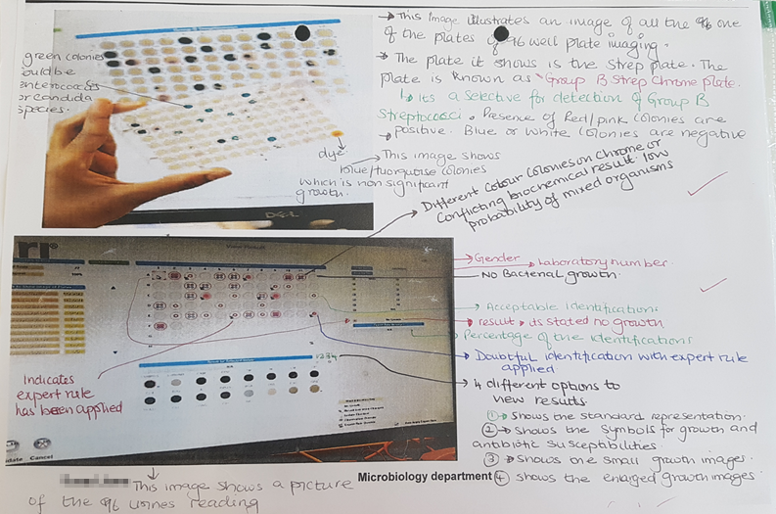
Example Data Interpretation
Commented on cell types
Commented on limitation of method
Identified as an abnormal result
Specific to this candidate and work they have done

Slide 24
Evidence of Feedback
Evidence of the trainer / mentor review, annotation and constructive feedback is expected on each piece of evidence (digitally - using track changes or comments on the piece of evidence, or using the text boxes on OneFile)
Good evidence will show a candidate undertaking a task, receiving constructive feedback, responding to this, and progress /updates can be seen in the final version of the piece of evidence.
Evidence of this feedback loop demonstrates a good relationship between trainer / mentor and candidate and is useful when assessing the quality of their training experience.

Slide 25
Types of Evidence
OneFile can accept a variety of file types – flexibility for videos / blogs / animations (note maximum file size)
Remember the indicative time for the verifier to review the 30 pieces of evidence is 90 minutes
The Training Officer will sign off to say the HCPC SoPs are met and that 3x pieces of evidence and module are completed

Slide 26
What to Avoid!
Essays
Long written pieces of evidence do not necessarily show good knowledge and understanding, just the ability to find information and format it (AI/ ChatGPT)
Seminar / training slides or a course certificate only
Better evidence:
A reflection on what they learned and how they will apply this to their practice and / or
Summarise the activity in the piece of evidence and how it has addressed a gap in their skills / knowledge to enhance their laboratory-based practice.

Slide 27
What to Avoid!
Witness statements are not good examples of evidence!
A witness statement that simply states someone else has watched the candidate complete a task does not ensure the candidate’s understanding of the HCPC standards of proficiency has been demonstrated.
A better piece of evidence would be a summary of a discussion with the person who observed the task being completed that includes feedback on what the candidate did well and some reflection on how they might improve next time.

Slide 28

What to Avoid!
Plagiarism / Academic Misconduct
If a piece of evidence includes published material (scientific information from journal articles or textbooks, images or information from laboratory SOPs, manufacturer instructions or diagrams) that is not the candidate’s, the sources should be clearly referenced using in text citations and a reference list at the end of the piece of work (or hyperlinks to the primary source of information).
If the diagram / information is original (ie they created it) the candidate should say so

Slide 29
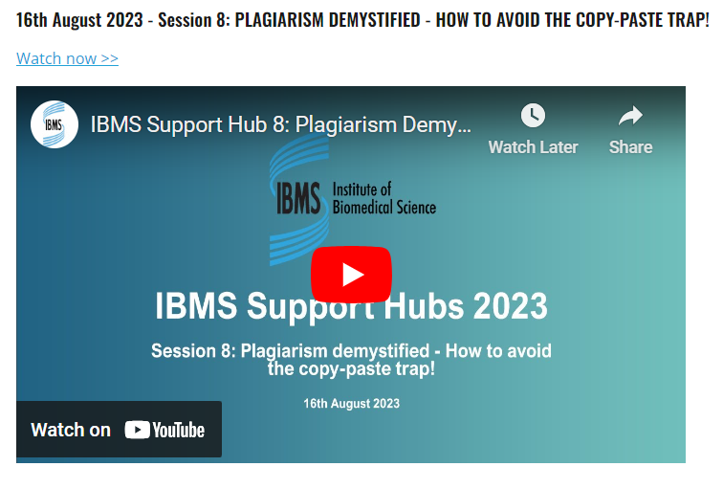
Plagiarism Support
August 2023 IBMS Support Hub:
https://www.ibms.org/resources/ibms-support-hubs-2023/

Slide 30

Thank you!
Any Questions?

